Slide 1

ONE
IS A WHOLE NUMBER
By Ardis Dick Stenbakken

Slide 2

THE SINGLE PERSON AND . . .
LONELINESS
SEXUAL DESIRES
COMPANIONSHIP
SPIRITUAL COMPLETENESS

Slide 3

“For in Christ all the fullness of the
Deity lives in bodily form, and you have been given fullness in Christ, who is the head over every power and authority. In Him you were also circumcised, in the putting off of the sinful nature, not with a circumcision done with the hands of men but with the circumcision done by Christ, having been buried with Him in baptism and raised with Him through your faith in the power of God, who raised him from the dead.”
Colossians 2:9-12, NIV

Slide 4
“I would like you to be free from concern.
An unmarried man is concerned about the Lord’s affairs—how he can please the Lord. But a married man is concerned about the affairs of the world—how he can please his wife—and his interests are divided. An unmarried woman or virgin is concerned about the Lord’s affairs: Her aim is to be devoted to the Lord in both body and spirit. But a married woman is concerned about the affairs of this world—how she can please her husband. I am saying this for your own good, not to restrict you, but that you may live in the right way in undivided devotion to the Lord.”
1 Corinthians 7:32-35, NIV

Slide 5
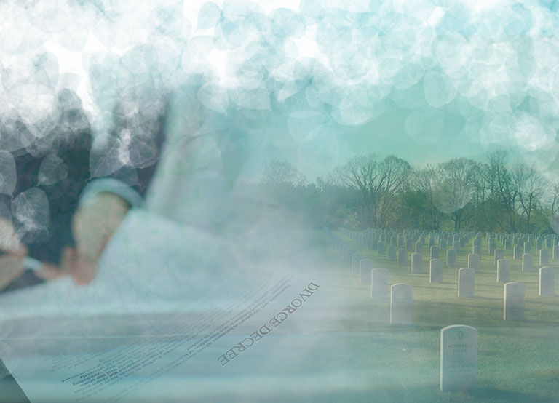
DIVORCE
DEATH

Slide 6

SINGLE BY CHOICE OR CIRCUMSTANCE

Slide 7

MARRIAGE PREFERRED
MARRIAGE AT ANY COST
MARRIAGE IMPOSSIBLE
SINGLENESS PREFERRED

Slide 8

IT’S NOT THAT I’M UNMARRIED,
IT’S THAT YOU’RE UNSINGLE

Slide 9

THE FEAR OF LONELINESS
eating
leisure time
worshiping
working
exercising
sleeping

Slide 10

The one thing worse than being alone is not being alone, and wishing you were.

Slide 11

COLOR YOUR WORLD
JOB
CHURCH
PRAYER AND BIBLE STUDY
SERVICE TO GOD
FRIENDSHIP WITH SINGLES
FRIENDSHIP WITH MARRIEDS
SOCIAL LIFE (INCLUDES DATING)
SPARE TIME

Slide 12

Dear God,
I don’t ever feel alone since I found out about You!!
Barbara

Slide 13

AVOID BECOMING A RECLUSE.
“Don’t talk yourself into staying home, convincing yourself that you would rather read a good book
than be out doing something with someone else.
Too many young people miss so much in life because they are afraid to cultivate various types of friendships. They are so busy hunting for their one and only that they miss the blessings of good friends along the way.”
Dr. Kay Kuzma, When You Are Serious About Love

Slide 14

“Happiness is like a butterfly. The more you chase it, the more it will elude you. But if you turn your attention to other things, it comes and softly sits on your shoulder.”
Nathaniel Hawthorne

Slide 15


Slide 16

WHY GOD INVENTED SEX
“I believe marriage was God’s crowning act of creation. God gave marriage to man to help him comprehend the eternal oneness of the Godhead and to symbolize His relationship to man.
What better symbol could God design for complete unity than sexual intercourse? Two different individuals, a male and female, joining together in the highest and most intimate form of human love.

Slide 17
To further symbolize the unchanging unity of the Godhead and God’s unchanging relationship to man, marriage should ideally be a lifetime relationship. In order for men and women to be constantly reminded of their commitment to this lifetime unity with their marriage partners, God created sexual intercourse…
Think about it—there is nothing else in the marriage relationship that has this same meaning. Sexual intercourse is the only human act that God reserved exclusively for a marriage partner. And each time this oneness is expressed…it reminds the couple of the lifetime commitment they have made to each other.”
Dr. Kay Kuzma, When You’re Serious About Love

Slide 18

WHAT GOD SAYS
Exodus 20:15 You shall not steal.
Exodus 20:14 You shall not commit adultery
1 Corinthians 6:13 Now the body is not for sexual immortality
but for the Lord.
1 Corinthians 6:18, 19 Flee sexual immorality… he who commits
sexual immorality sins against his own body.
Or do you not know that you body is the
temple of the Holy Spirit who is in you, whom
you have from God, and you are not your own?
1 Thessalonians 4:3 For this is the will of God, your sanctification:
that you should abstain from sexual immorality.

Slide 19
WHAT GOD SAYS
1 Thessalonians 4:4-6, NIV
Each of you should learn to control his own body in a way that is holy and honorable, not in passionate lust like the heathen, who do not know God; and that in this matter no one should wrong his brother or take advantage of him.
Ephesians 5:3, NKJV
But fornication and all uncleanness or covetousness, let it not even be named among you, as is fitting for saints.

Slide 20
“I say this by way of concession,
not of command. I wish that all were as I myself am. But each has his own special gift from God, one of one kind and one of another. To the unmarried and the widows I say that it is well for them to remain single as I do. But if they cannot exercise self-control, they should marry. For it is better to marry than to be aflame with passion.”
1 Corinthians 7:6-9, RSV

Slide 21
NINETEEN REASONS TO SAY NO!
God said so.
Sex before marriage can become a binding force leading to marriage based on sex and not friendship.
Flashbacks of previous sexual encounters can haunt a marriage.
Sex can cover up serious difficulties in a relationship.
Sex can make it difficult to distinguish between real love and infatuation.
Premarital sex can trigger lifetime guilt and regret.

Slide 22
NINETEEN REASONS TO SAY NO!
Guilt feelings over sex before marriage can be carried over to sex in marriage.
Premarital pregnancy.
There is an increased risk of cervical cancer among women who engage in sex with multiple partners.
AIDS and other sexually transmitted diseases.
Research seems to indicate premarital sex isn’t good for
marriage.
It destroys virginity.

Slide 23
NINETEEN REASONS TO SAY NO!
It destroys reputation and respect.
It can destroy trust in a relationship.
It destroys the value and meaning of the honeymoon.
Premarital sex tends to be habit-forming.
Attitudes often change after a premarital sex experience.
You never know whom you will marry.
It erodes a relationship with God.

Slide 24
IF YOU ARE HAVING TROUBLE WITH SEXUAL THOUGHTS AND FEELINGS . . .
What music are you listening to?
What pictures hang on your walls?
What kind of books do you read?
What movies do you watch?
What kind of stories do you tell or listen to?
What magazines do you look through?
Are you eating a healthy diet?
Are you getting good exercise?
What intimate situations do you allow yourself to be involved in?

Slide 25

Are you ready to commit your sexual desires to the Lord?
Are you ready to trust Him and His plan for their fulfillment?
If you’ve been struggling in this area, I encourage you to go before the Lord and honestly tell Him how you’re feeling.
Believe me, He won’t be shocked at anything you say.

Slide 26
BECAUSE IT IS COMMON
SENSE DOESN’T MEAN
IT IS COMMON PRACTICE.

Slide 27

HOW TO CATCH A MAN:
Be able to be happy by yourself.
If it is God’s will, there is someone God is preparing for you while you are preparing for him.

Slide 28
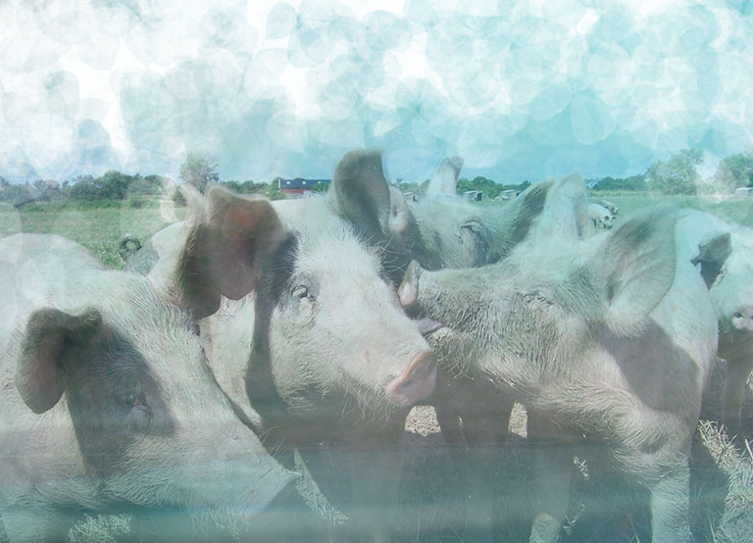
I DON’T KNOW, MAN.
I’M JUST TIRED OF DATING PIGS.

Slide 29
THE HARDER WE TRY,
THE LUCKIER WE ARE.

Slide 30
“A single person is often so determined that marriage is essential to his/her wholeness that subconsciously he bypasses both opportunities and responsibilities until they can be shared with a life partner. More seriously, this tendency to wait for the future can become a living pattern, canceling out many enriching experiences.”
Lyle Hillegas, It’s O.K. to Be Single

Slide 31
AVOID THE HAZARDS OF THE SINGLE LIFE
Hazard #1. You date someone with a questionable character because you are beginning to lose hope that the right one will ever appear.
Hazard #2. You are pressured into a sexual relationship thinking that it will encourage the person you are dating to make a permanent commitment to you.
Hazard #3. You rush into marriage thinking it may be your last chance.

Slide 32
ESTABLISH A CLOSER RELATIONSHIP WITH CHRIST
If you are lonely, make Jesus your constant companion.
Lean on His promises.
Develop the fruits of the spirit found in Galatians 5:22.
Love Joy Peace Long-suffering
Kindness Goodness Faithfulness
Gentleness Self control
Read Christian reading material.

Slide 33
MEMORIZE JEREMIAH 29:11-13
“For I know the plans I have for you, says the Lord. They are plans for good and not for evil, to give you a future and a hope. In those days when you pray, I will listen. You will find me when you seek me, if you look for me in earnest.” (TLB)

Slide 34
DON’T LET THE
GOOD THINGS OF LIFE ROB YOU OF THE BEST THINGS.
MALTHIE D. BABCOCK

Slide 35

HAPPINESS
IS NOT A DESTINATION.
IT IS A WAY OF
TRAVELING.

Slide 36

WAYS TO MANAGE STRESS
Have a support network.
Relax.
Eat well and regularly.
Lunch with a friend.
Smile.
Exercise daily.

Slide 37
WAYS TO MANAGE STRESS
Do something for someone else.
Do something you enjoy each day.
Take a walk.
Develop a meaningful relationship with Jesus.

Slide 38
FOR THAT SPECIAL SOMEONE . . .
“The Lord is disappointed when
His people place a low estimate upon themselves. He desires His chosen heritage to value themselves according to the price He has placed upon them. God wanted them, else He would not have sent His Son on such an expensive errand to redeem them.”
Ellen G. White, Desire of Ages, p. 657

Slide 39

STAGNATING? OR BUILDING?
Stagnating | Building
Avoiding Problems (The ostrich syndrome) | Problem Solving
Living Life in the Future (“When I _____, then I’ll . . . “) | Living Life NOW
Staying in a Rut | Seeking New Challenges
Refusing to Change | Looking for Ways to Adapt
Complaining | Making Reasonable Changes
Seldom Having Guests | Being Hospitable

Slide 40
Rating Scale: 1-low or nonexistent 2-average 3-high
ANALYSIS
Relationships with others | Frequency | Enjoyment | Depth | Total
Immediate Family Father, Sister, etc.
Relatives
Close Friends
School Friends
Work Associates
Church Family
Others

Slide 41
Rating Scale: 1-low or nonexistent 2-average 3-high
ANALYSIS
Relationships with others | Frequency | Enjoyment | Depth | Total
Personal Prayer (quiet time)
Personal Bible Study
Worship (corporate)
Trust
Love
Obedience

Slide 42
Rating Scale: 1-low or nonexistent 2-average 3-high
ANALYSIS
Relationships with others | Frequency | Enjoyment | Depth | Total
Attitudes toward myself.
I take time to be alone.
I have hobbies.
I take time with my appearance.
I work out problems.
I take time to exercise.
I do things that are fun.

Slide 43

God supplies each person (that includes singles!) in the church with the resources for ministry–scripture, spiritual power, God’s character, and spiritual gifts.

Slide 44

A SINGLE ADULT MINISTRY SHOULD NEVER EXIST TO MEET ONLY ITS OWN NEEDS.
IT MUST EXIST TO SERVE A LARGER COMMUNITY AND MEET THE SPIRITUAL AND HUMAN NEEDS.

